Slide 1
Saint Edward’s Catholic Academy
RSE Meeting
Wednesday 6th June 2018

Slide 2
Aims
To explain what RSE looks like in a Catholic School.
To introduce ‘A Journey in Love’.
To give an outline of the taught curriculum in each year group.
To explore the curriculum material in different year groups.
To explain how we will be delivering RSE this year.
To share the compulsory elements of the RSE
curriculum.

Slide 3
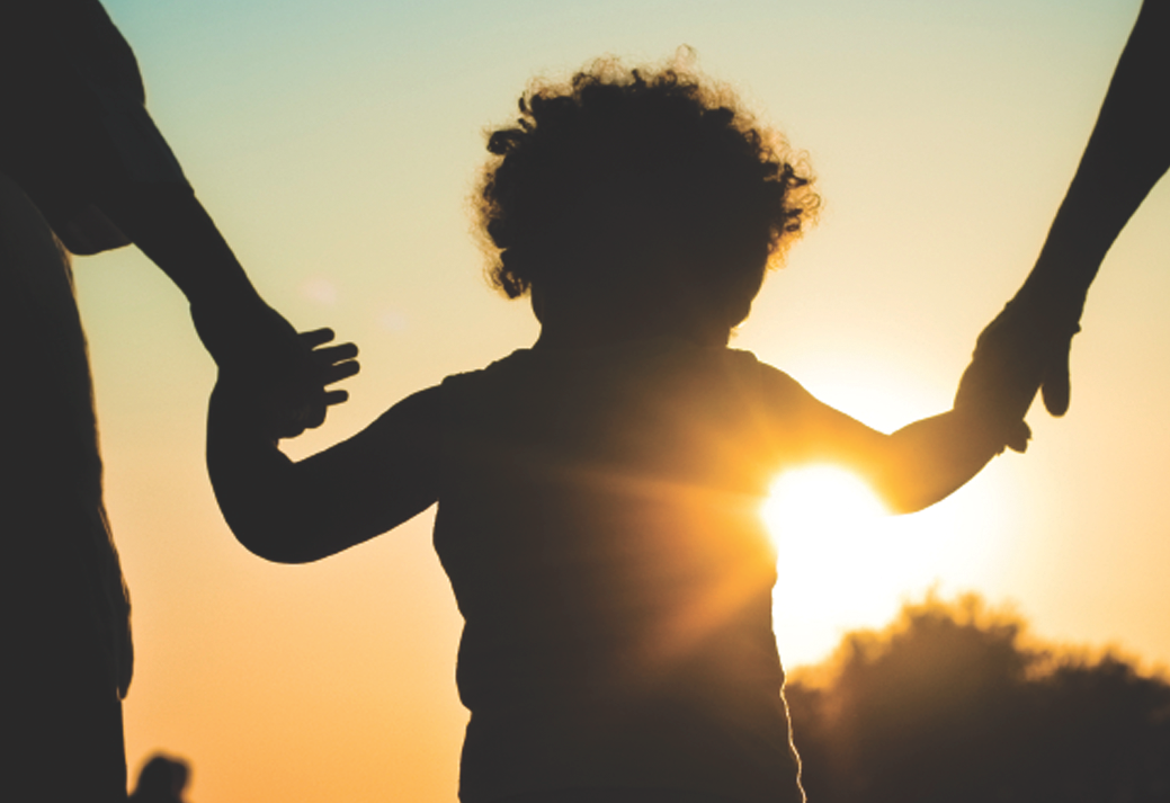
RSE – Parents and carers
At St Edward’s we are committed to delivering an RSE curriculum that reflects the teaching of the Catholic Church and the Department for Education requirements.
However, we recognise that
parents and carers are the
primary educators of children.
Your role in the education of
your children at home in
regards to RSE is crucial.

Slide 4
RSE in Catholic schools
Catholic schools, like all other schools in England, are required to produce a written policy following the guidance issued by the Department for Education on Sex and Relationship Education (SRE).
Catholic schools are also required to deliver RSE in accordance with the teaching of the Church. This approach is compatible with the guidance issued by the DfE.

Slide 5
Why is RSE in Catholic Schools important?
RSE is part of the mission of Catholic schools to educate the whole person.
It should be carried out as part of the holistic education which seeks to form as well as inform young people in preparation for adult life.

Slide 6
What does outstanding RSE in Catholic school look like?
In order for Catholic RSE to be fully effective it needs to:
•be faithful to the Church's vision of human wholeness whilst recognising the contemporary context in which we live today;
•involve parents as they are primary educators of their child;
•provide a positive view of human sexuality and dignity of the human person;
•equip young people with the ability to make practical judgments about the right thing to do in particular circumstances;
•explore and promote virtues which are essential to promoting respect and dignity;

Slide 7
Children are given opportunities to take part in activities which;
•Encourage them to reflect on their own relationships in order to develop an understanding of themselves, their sexuality and that of others
•Help them acquire the skills necessary to develop and sustain relationships
•Develop self-confidence and self-esteem
•Help them to consider personal attitudes and make responsible decisions
•Present facts in an objective and balanced manner and use appropriate terminology
•Enable them to discuss issues without embarrassment or fear of ridicule
•Encourage them to discuss and challenge the message given out by their peers and the media

Slide 8
Children are given opportunities to take part in activities which;
Enable them to make informed decisions to help them to assess, avoid and manage risk
Develop effective ways of resisting pressures, including knowing when and where to get help
Use assertiveness techniques to resist unhelpful pressure
Develop skills to cope with emergency situations
Help them to understand rules, rights and responsibilities
Enable them to consider different points of view
Explore moral, social and cultural issues

Slide 10
A Journey in Love
This scheme has as its core the belief that we are made in the image and likeness of God and as a consequence, gender and sexuality are God’s gift.

Slide 11
A Journey in Love
An aspect of the mystery of love is covered in each year group. Children are encouraged to marvel at the wonder and beauty of God’s love. This is reflected through a series of suggested, progressive and developmental tasks which focus on physical, social, emotional, intellectual and spiritual development.

Slide 12
Reception
Emotional How do you feel about your friends? Do you both have other friends at school /home? Why do you play with them? Intellectual Is it important to have friends? Describe a good friend Spiritual Is Jesus our friend? Read the story ‘Jesus Welcomes the Little Children’ and talk about children being special to God Who is the mother of Jesus? Why is she special? Jesus grew for nine months in Mary’s womb
Physical Does it matter if we are different? Look at me – how am I different from you? Look at you – how are you different from me? Social With whom do I play with at school/home? Why does (x) play with me? What are your favourite games?

Slide 13
Year 1
Emotional What are the happiest moments in your family? What are the saddest moments in your family? How is love shown in your family? Intellectual Why do we need to grow up in families? What happens if you grow up without a family? What would you miss? Spiritual We are members of God’s family How were we born into God’s family? What special title do we give to God as members of God’s family?
Physical Who is in my family? How many children have babies in their families?
Social Invite children to share their home research about their early development. Parents share the wonder and excitement of these moments of growth and development for them.

Slide 14
Year 2
Emotional How does a community help us to develop our feelings and emotions? Are we always happy in our community? Are we, as a community sometimes sad or upset? Intellectual Could people feel alone even though they belong to a community? What would they miss out on? What are the advantages of being on your own? Spiritual If God is called ‘Our Father’ what does that make us? As children of God how should we treat each other?
Physical Do you belong to a community? What other community do you belong to? How do you belong to these communities? Social Is belonging to a community important? What do we receive from the community we belong to? What do we give to the community we belong to?

Slide 15
Year 3
Emotional How do you feel when a friend is not there for you? How do your friends feel when you are not there for them? How can you be a more supportive friend? Intellectual Can you recognise the difference between being alone and being lonely? To recognise the need for personal privacy Spiritual The story of the outcast Zacchaeus – Jesus accepted him as a friend, welcomed and forgave him. How can I forgive and include others as Jesus did?
Physical Who takes care of me? How do I look after myself? How am I changing? Social How do I keep myself safe? How do I help others to make and keep friends? How do I take care of others?

Slide 16
Emotional How do I appreciate my own gifts, talents, achievements and all that makes me unique? How do I appreciate others and the gifts they have been given? How do I deal with the natural, negative emotions that present themselves? Intellectual Can I identify and name my feelings? Do I know and understand what these feelings are? How do I deal with what I feel, can I analyse my feeling and actions? Spiritual St Paul’s teaching on love.
Physical Recognise that all pupils grow and develop at a different rate. Name the different male and female body parts and introduce their functions. Identify the development of the baby in the womb. Social How do I learn to accept and celebrate who I am? How do I accept difference in others? How do I deal with difference and manage the conflicts that arise?

Slide 17
Social and Emotional
Recognise behaviour changes as we grow up. Expectations are different and are often dependent on out experiences, and treatment of others, and our view on the world in which we live.
Reflect on ways to become more sensitive to the emotional development of others and themselves.
Spiritual
Share and celebrate the wonder of change.
Physical and Intellectual Identify and celebrate the ways in which I have changed since birth.
Discuss the external and internal changes which happen to girls and boys in puberty.
Recognise that sexual development is a natural part of human growth and that physical changes from child to adult means the ability and potential to become a mother or father.

Slide 18
Social Recognise and compile a list of signs of love expressed in those around us. Reflect on the different degrees of friendship that exist. Spiritual God causes new life to begin through the love that parents have for one another. To celebrate God’s creative love in creating us as his children and recognise that we grow as human beings.
Physical Explain how human life is conceived. Emotional Relationships develop and eventually you may be able to use the word love and lead to marriage.

Slide 19
RSE at St Edward’s Catholic Academy
This year RSE will be taught in the week beginning 18th June as a special topic week. We will teach the ‘Journey in Love’ scheme through RE, PSHE and Science lessons.
Next year we are planning to embed RSE into other curriculum areas such as RE, PSHE and Science throughout the academic year.
As this is the first year that we have taught RSE this way we would greatly appreciate your feedback so that we can strive to deliver the best provision for your children.

Slide 20
Withdrawing children from RSE
You have the right as a parent/carer to withdraw your children from parts of the RSE curriculum.
All teaching on relationship education is compulsory for all children in primary education. This applies to all the RSE teaching in Foundation Stage and Key Stage 1.
In Key Stage 2 you have the right to withdraw your child from elements of the sex education curriculum, however the elements that are part of the Science curriculum remain compulsory.
In September 2019 all RSE will become compulsory for children in KS1 and KS2.

